Slide 1
Thinking Skills
Heather Clemson

Slide 2
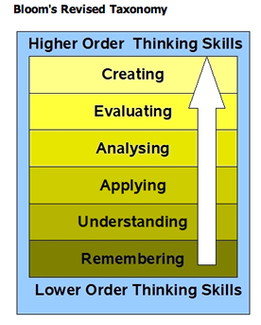

Slide 3
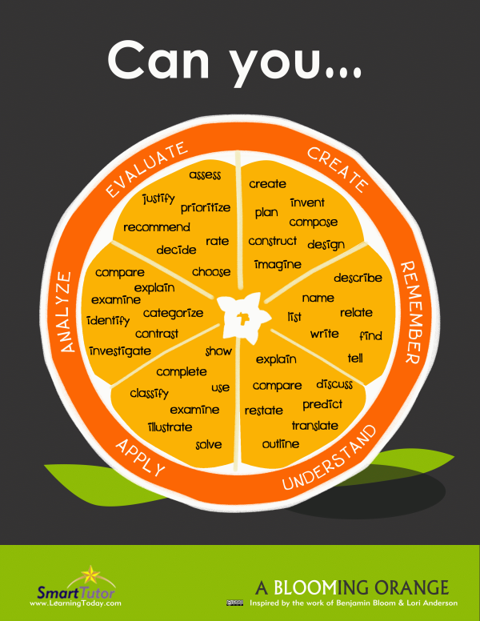

Slide 4
1. `Remembering`
Recognising, listing, describing, identifying, retrieving, naming, locating, finding
Rhythms, pitches, shape
Eg.pieces that are in C major, right hand only, staccato, legato
Hear `Mary` and know they have heard it on the CD or are learning to play it and name it.
Know where to start on the keyboard
Finding the notes correctly
Playing a review piece

Slide 5
1. `Remembering` - Q`s
What is?
Where is?
How would you explain?
Describe – show – what happened after?
Can you outline – identify?
What happened after this……….?
What happened – where?

Slide 6
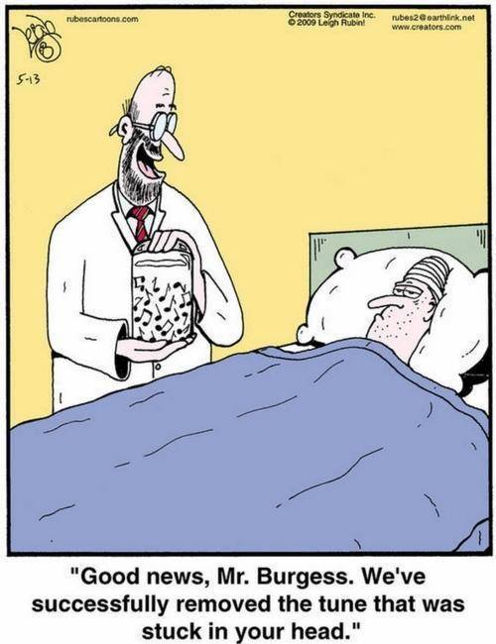
A bad case of `Remembering`!

Slide 7
2. `Understanding`
Interpreting, summarising, inferring, paraphrasing, classifying, comparing, explaining, exemplifying.
Interpreting the written music and following the instructions
Interpreting and understanding what the signs and musical phrasing mean
Able to say that there are three `dance like` pieces in Bk 1 and four in Bk 2 etc
Or perhaps that all the staccato pieces have descriptive names.
Able to compare one piece with another in various ways
Able to explain that with staccato you do ……. with your hand and with legato you do…….

Slide 8
2.`Understanding` - Q`s
How would you say – tell in your own words?
How would you compare – contrast?
What might have happened next?
What example could you give of?
What do you think about…………….?

Slide 9
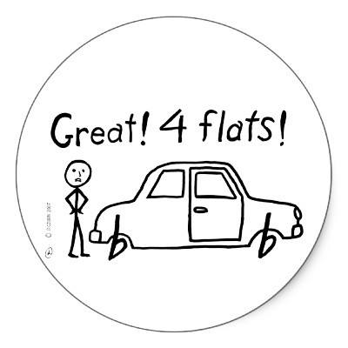
2. Understanding!

Slide 10
3. `Applying`
Implementing, carrying out, using, executing
The pupil has understood the various ideas/instructions and puts them into effect
Able to carry out his/her ideas – do an exercise as you have asked.
They use your suggestions at home or in the lesson

Slide 11
3. `Applying` - Q`s
What would happen if…………..?
What can you use to show or explain……….?
Can you sort this by features such as…………?
How would you solve?
What factors would you change if………….?
How is…………….an example of?

Slide 12
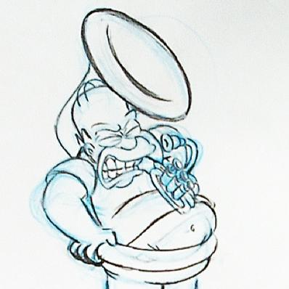
Homer is applying himself to a problem!

Slide 13
4. `Analysing`
Higher order thinking
Comparing, organising, deconstructing, attributing, outlining, finding, structuring, integrating
Comparing music and transferring knowledge previously understood in other pieces to the current piece.
eg. realising that the end of section A in Go Tell is the same notes as the end of section A in Allegro – but played more staccato in Allegro than Go tell Aunt Rhody.

Slide 14
4. `Analysing`
Higher order thinking
Deconstructing - `chunking` music for clarity – exercises – form – structure – musicality - technique.
Knowing that Twinkle is a `sandwich` and being able to compare with Go Tell and May Song and Judas Mac
Integrating internalised knowledge – tone production, musical phrasing, dynamics following the shape of the musical pitch of the melody.

Slide 15
4. `Analysing` - Q`s
What is similar to………..or different from?
What is the underlying theme – meaning?
Who/what do you think…..?
What conclusions can you draw?
Can you explain what would have happened when……………?
Is the information based on fact or opinion?

Slide 16
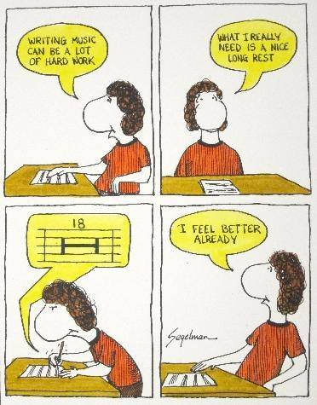
Analysis of the situation?

Slide 17
5. `Evaluating`
Checking, hypothesising, critiquing, experimenting, judging, testing, detecting, monitoring
The pupil thinks about what they have played and actively works out how to develop their own playing further
Hypothesising – what if I did this – how would it sound if I could try this – when I did this it sounded like a ……… - maybe I will try that again and do this ………….

Slide 18
5. `Evaluating`
Experimenting – transpose into another key, play sadly – play like a march – play in minor key instead – change the dynamics – play one hand quietly and the other loudly and able to evaluate/consider the effects.
Making judgements about their own playing and others`
Knowing when they have made a mistake and being able to work out where and why and what to do next.

Slide 19
5. `Evaluating` - Q`s
What would happen if………………?
What is your opinion of…………?
How could…………………be improved?
What shows you that…………….happened?
Do you agree with the outcome?
Using what you know about………………….how would you explain?
What evidence supports your view?

Slide 20
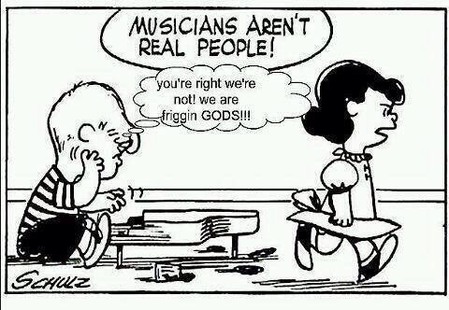
Great evaluation going on here!

Slide 21
6. `Creating`
Designing, constructing, planning, producing, inventing, devising, making
Pupils think about how they play, they design their interpretation – discussion, listening
They work with others to produce collaborative, well thought out group work using opinions and discussion
They create/experiment with their own music – perhaps using the teacher or peers to bounce ideas around
They invent mind pictures – sound pictures
They devise - imagine and make the music so that they `own` it.

Slide 22
6. `Creating` - Q`s
What might be a solution to?
Can you come up with an idea that would………….?
How many ways can you……………….?
How would you create/improve/develop……?
What might happen if………….?

Slide 23
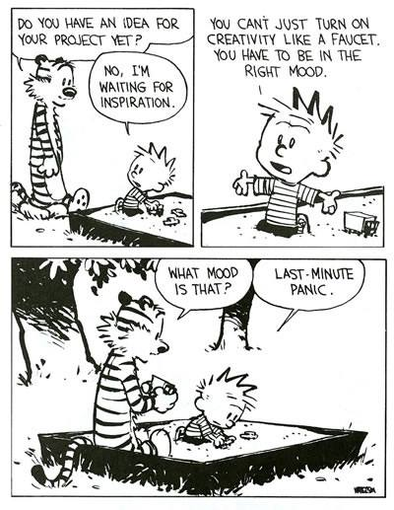
Creativity is not easy!

Slide 24
i. Teaching each other - `LOTS`
Devise a `mini` lesson and demonstrate a situation using `Lower Order Thinking Skills`(`LOTS`)
Be the teacher using `LOTS`
Be the pupil using `LOTS`

Slide 25
ii. Teaching each other `HOTS`
Devise a `mini` lesson and demonstrate a situation using `Higher Order Thinking Skills` (`HOTS`)
Be the teacher using`HOTS`
Be the pupil using `HOTS`

Slide 26


